Slide 1
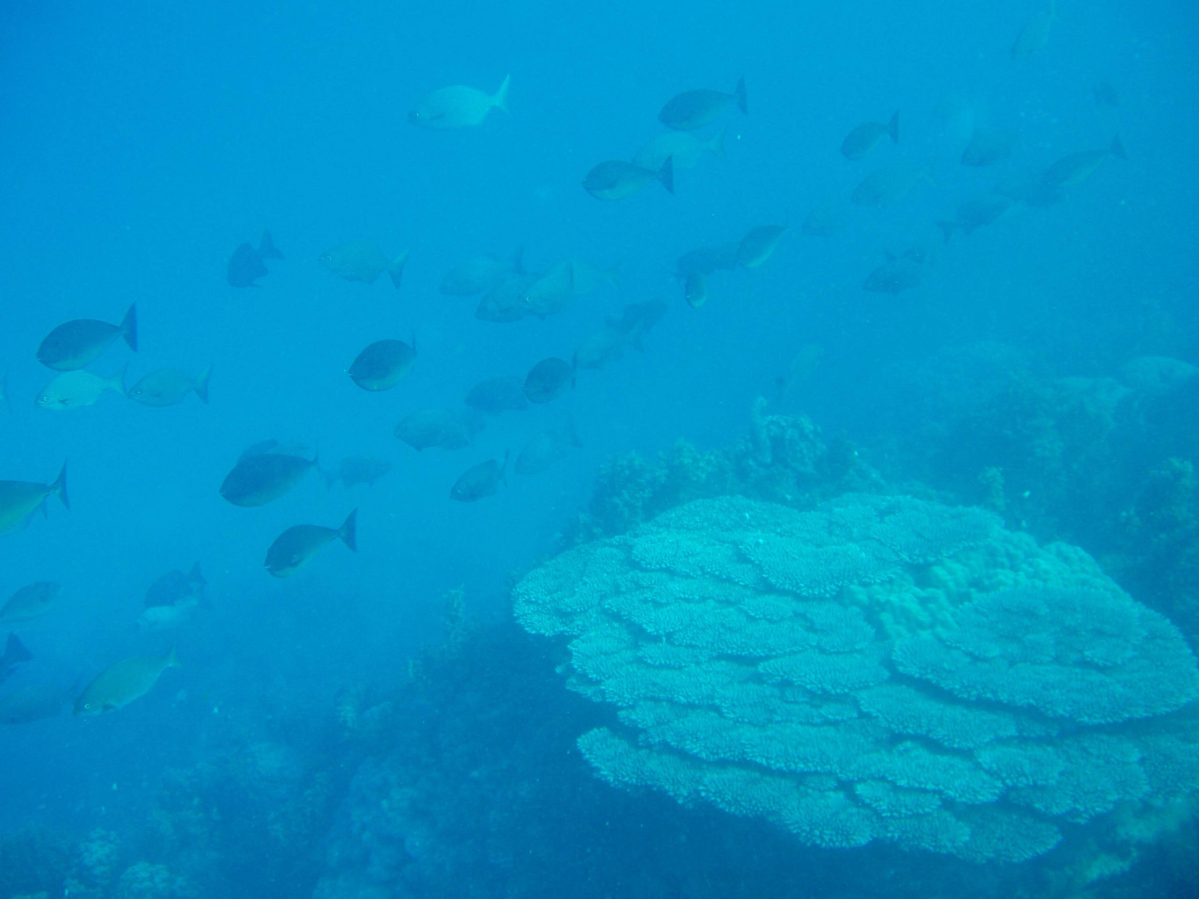



Biological traits predict reef fish movement
Lizzie Tyler
Fernando Cagua,
Andrea Manica, Alex Vail
Michael Berumen
Notes:
This talk is about a project coming out of my lab at the Red Sea Research Center at KAUST in Saudi Arabia.
This project was led by my postdoc Lizzie Tyler, who couldn’t give the talk because she is expecting a baby, with the help of Fernando Cagua, a master’s student in my lab. We also collaborated with Andrea Manica and Alex Vail from Cambridge University. The aim of our project is to see if we can come up with useful predictions about movement rates in coral reef fish communities by measuring movement across a large number of species in the Red Sea and linking this movement to species biological traits.

Slide 2
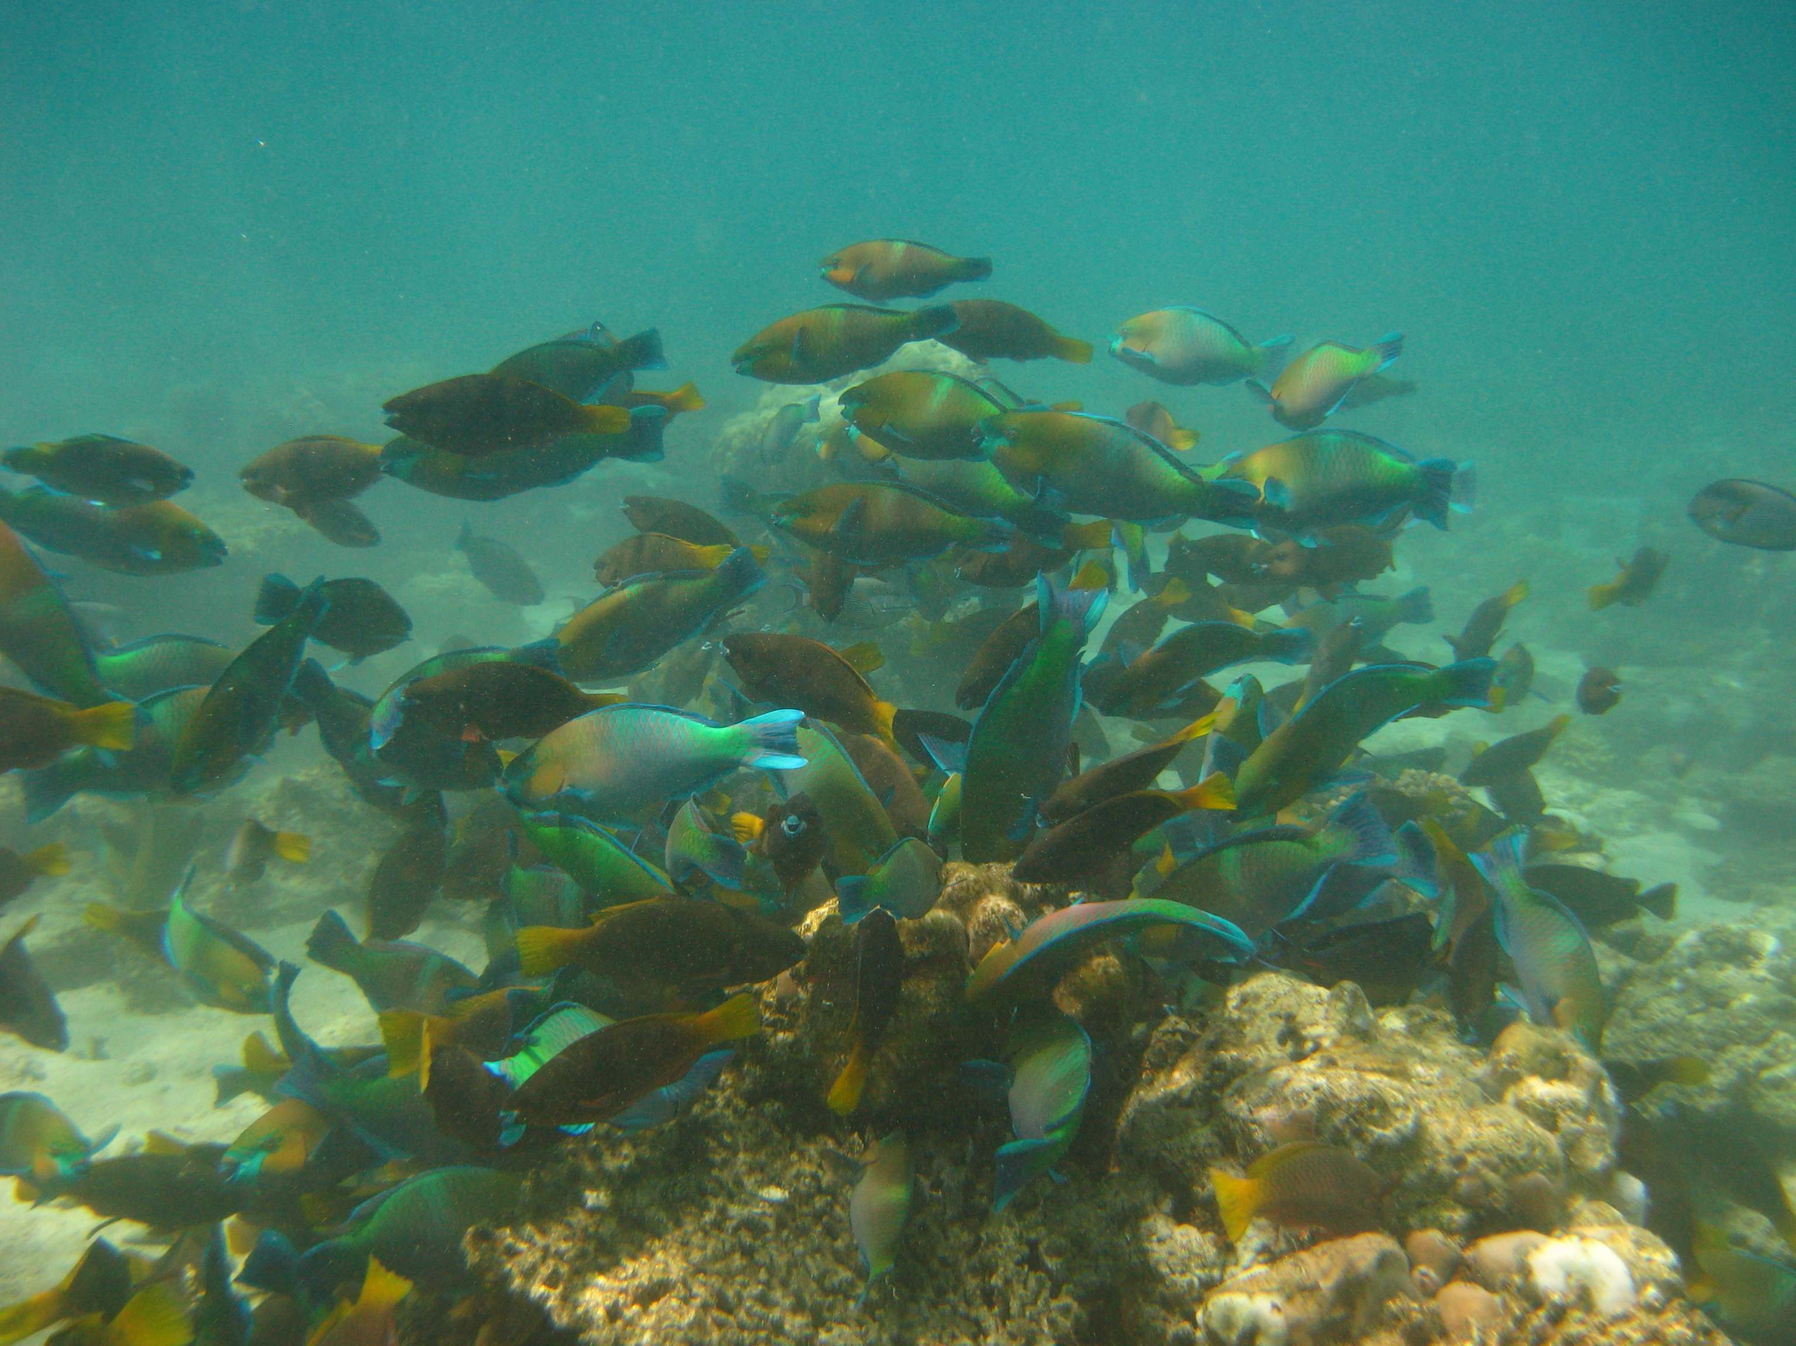
Adult fish movement
Determines spatial scale of management for - reef function
- fisheries
Notes:
Adult fish movement is extremely relevant to the role of fishes in coral reef ecosystems (this session) because it determines the spatial scale on which processes involving adult fish operate. For management purposes, we need information on fish territory size and the frequency of long-distance movements in order to know how to size and space MPAs to preserve functions provided by adult fishes that are critical for reef health, such as herbivory; Movement of adult fish is likely to be particularly important in determining reef recovery on short time scales- i.e. following a disturbance event. Movement is also obviously relevant to the design of MPAs for fisheries management.

Slide 3
Evidence for fish movement
Within reefs: 15-27 km (Kaunda-Arara 2004: 7 species;
Rhodes & Tupper 2008: 1 species)
Between reefs: 0.5 - 6 km (Chateau & Wantiez 2009: 4 species)
Few species per study/location
Larger fish (Munro 2000; Meyer 2010: 11 species)
Herbivores, planktivores, benthic invertivores (Munro 2000;
Meyer 2010: 11 species; Kaunda-Arara 2004: 7 species)
Little hypothesis testing; mostly anecdotal evidence for patterns
Notes:
Existing evidence suggests that some fish species are capable of moving tens of kilometres within reefs and up to 6 km between reefs
However, existing information is very scattered, comprising many studies of only one or several species in different locations and habitats. We are still lacking a comprehensive comparison of a large number of species in a single location, allowing us to directly compare movement rates across the fish community
Existing studies also suggest that there are some patterns to this movement, that larger fish seem to travel further, and there are indications that certain groups may also travel further. However, these patterns have not been rigorously tested. There has been almost no hypothesis testing, making it hard to find patterns that will enable us to apply results to locations with different species compositions- in way that is useful to marine reserve managers; generally studies on fish movement lack power (no. individuals/species) to test hypotheses;

Slide 4
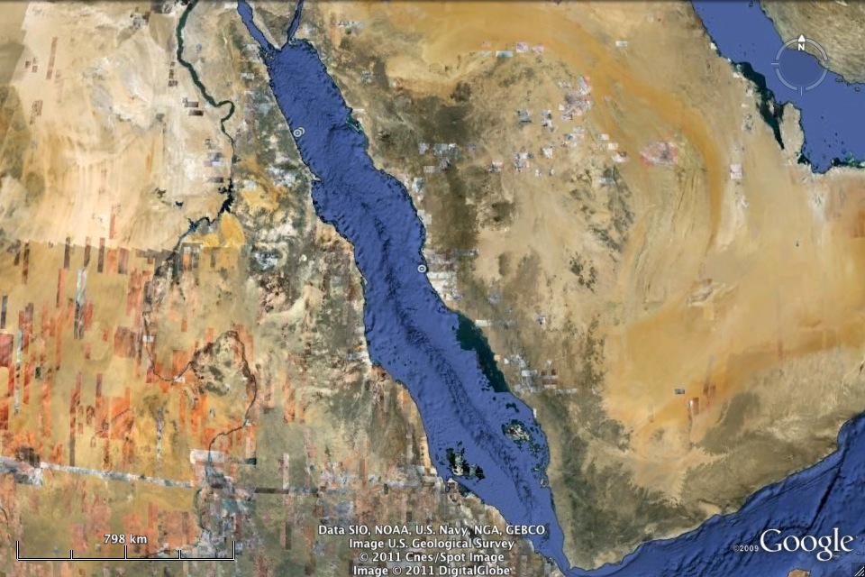
Saudi Arabia
KAUST
Jeddah
Al-Lith
Notes:
Al-Lith lies 300 km south of our university, KAUST, based, near Jeddah in Saudi Arabia

Slide 5
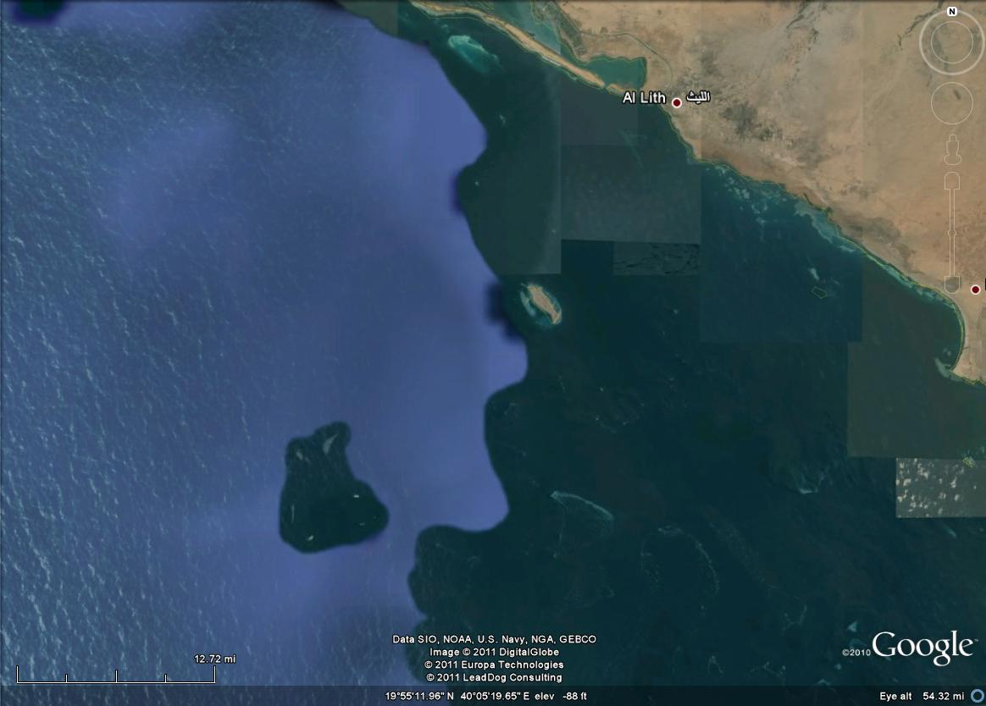
Al-Lith
Notes:
This group of reefs is located in the northern Farasan banks of the Red Sea, 52 km offshore from the coastal town of Al-Lith
Due to their distance from shore, these reefs therefore had very little artisanal fishing pressure, so had reasonably healthy fish communities, despite not being protected (there are currently no No-Take Areas in the Saudi Arabian Red Sea).

Slide 6
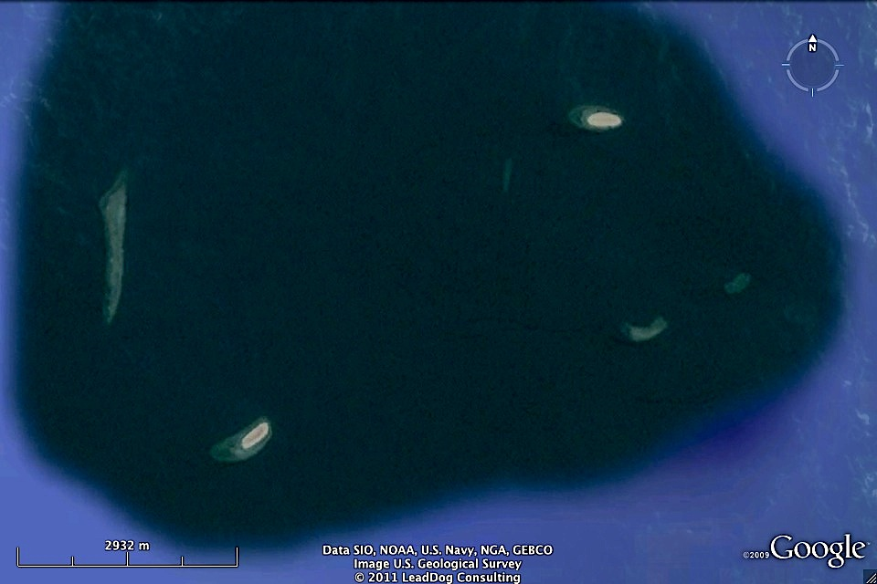
6 study reefs
Measure movement within and between reefs
3 km
Notes:
The aim of our study was to identify patterns in movement across the fish community, and see whether we could predict movement from species biological traits. We therefore wanted to measure movement across a large number of species and individuals in one location. We also wanted to quantify movement both within and between reefs, because previous research suggests that these may elicit different rates of movement.
We chose a group of six reefs, separated from each other by distances ranging from between 800 m to 7 km of deep open water (approx 100 m deep). Whilst these 6 reefs ranged in size from between 1 and 5 km in circumference, they had very similar topographies. They are typical of offshore reefs in the Red Sea, with steep vertical walls and shallow flat tops and have high hard coral cover, very low macroalgal cover, and at least one sand plateau on each reef.

Slide 7
Acoustic telemetry: array of 30 receivers
Measuring adult fish movement
Within-reef movement
Receivers every 200 m
n = 10
x
x
x
Between-reef movement n = 9
x
x
x
x
x
x
Receivers every 200 m
n = 11
Notes:
The ideal method for measuring movement on this sort of scale is acoustic telemetry, because it provides two major advantages over conventional tags- it provides continuous movement data for the lifetime of the tag (in our case over a year) and for a fraction of the effort involved in resighting or recapturing conventionally tagged fish.
We established an array of 30 acoustic receivers, moored to these reefs, spaced approximately every 200 m around the circumference of two reefs in which we planned to measure within-reef movement- to provide relatively high resolution measurement of within reef movement. Nine receivers were also placed in strategic positions on the remaining 4 reefs to capture between reef movements.
The data we get back from each receiver consists of a log of all the detections occurring at that receiver location- comprising the date, time and unique ID number of the tag, and of course we can then match these data to the precise location where that detection took place.
Please go to Fernando Cagua’s talk on Wed in the reef technology session at 11:15 for more information on acoustic telemetry and how we tested the range between tags and receivers to design our array.

Slide 8
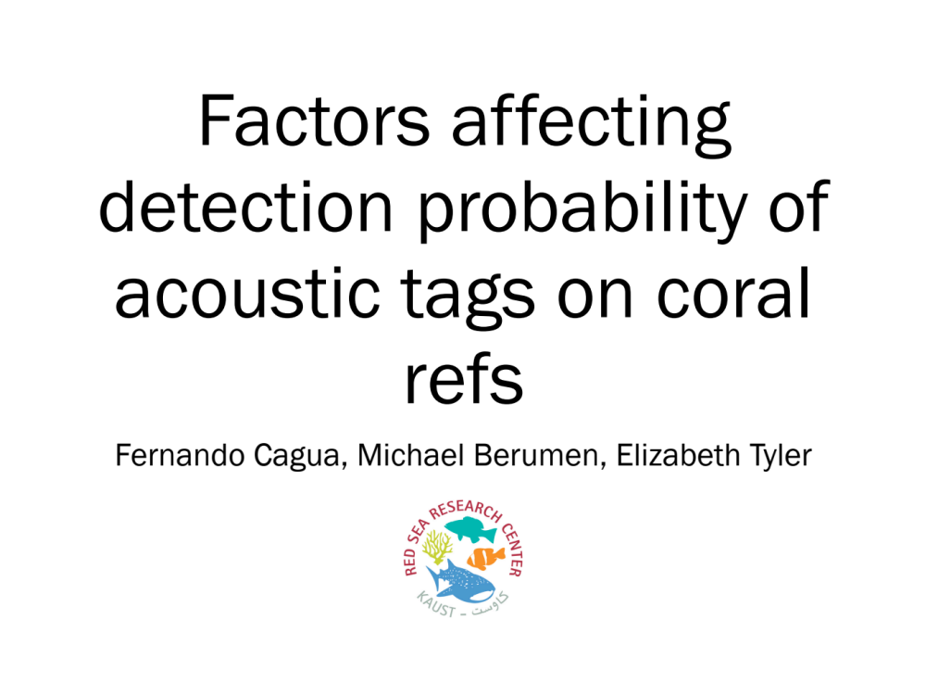
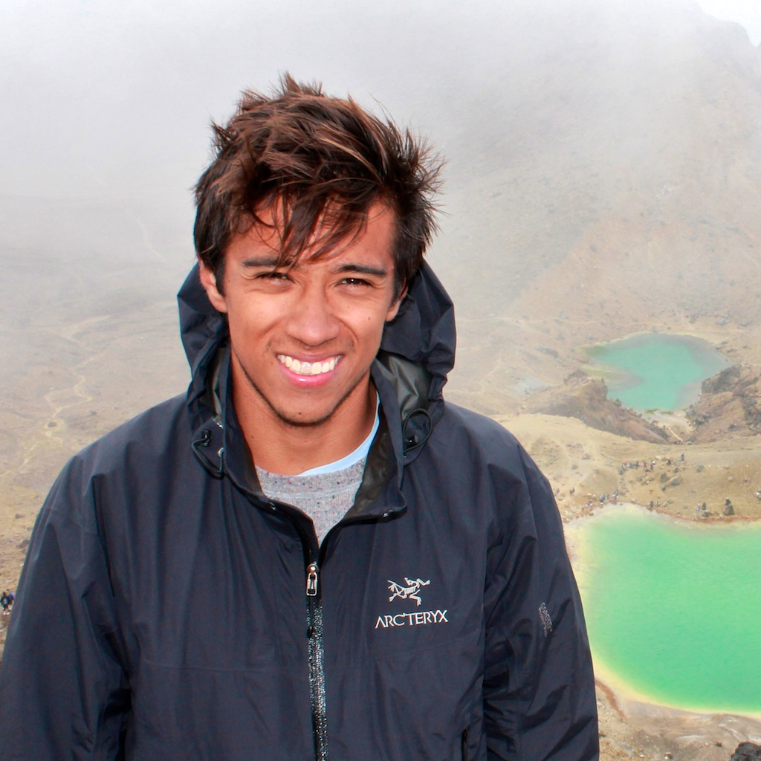
reefs
Wednesday, 11h30, Sebel Mossman

Slide 9
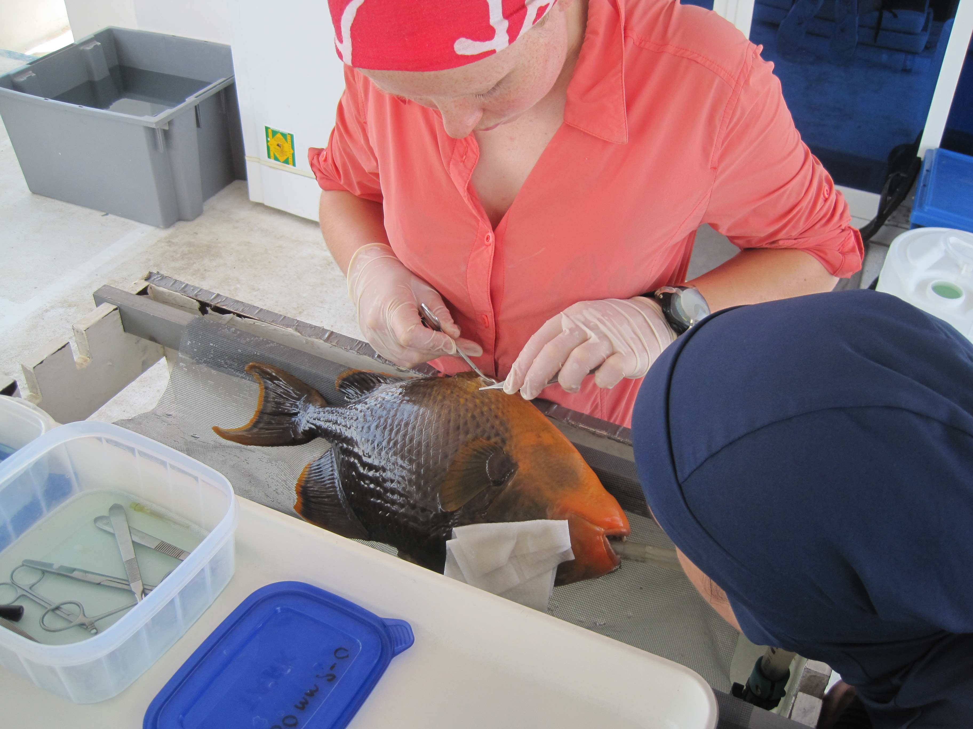
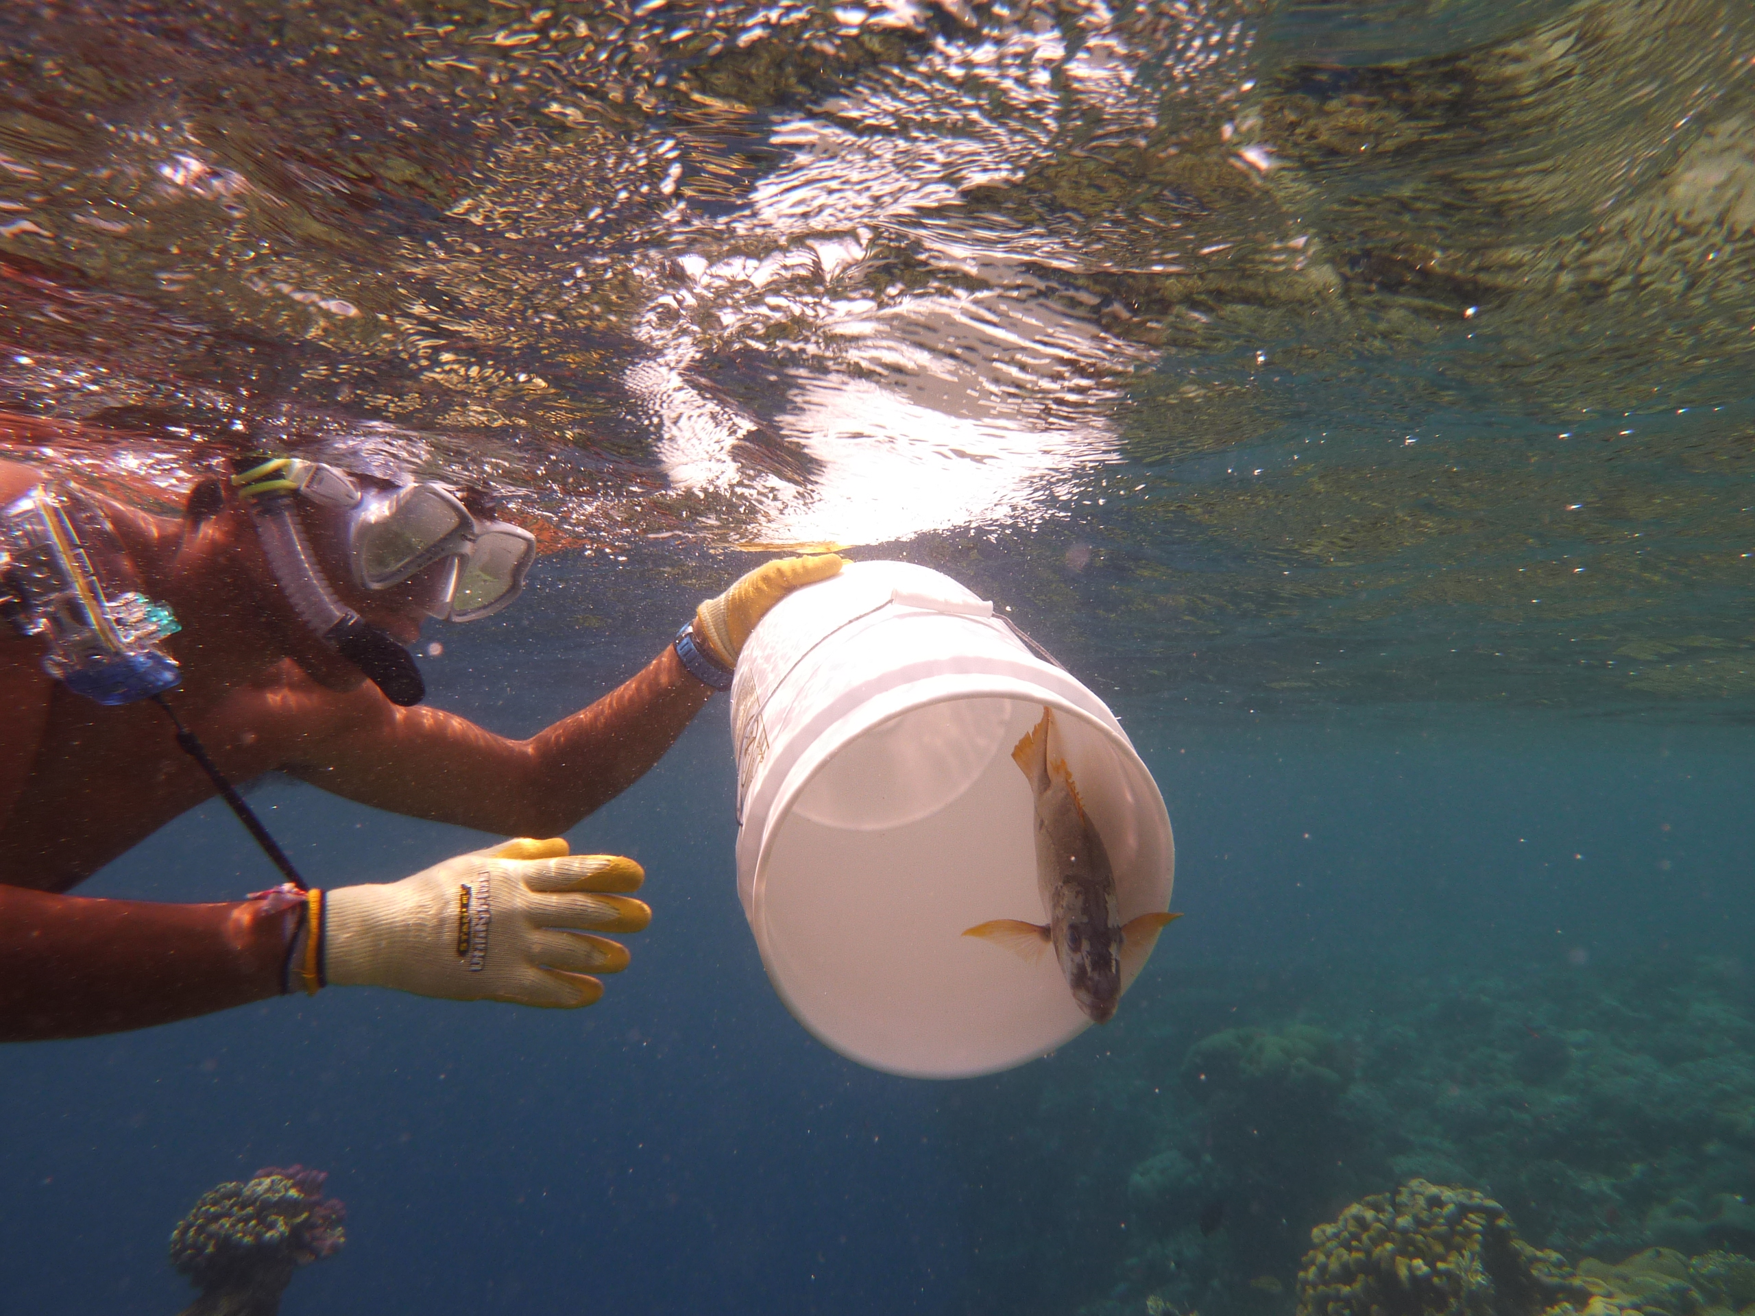
Fish tagging
400 fish; 42 species; divided between two reefs
Capture, surgery, recovery, release on same day
Vemco V13-1H tags, equal detectability
Minimum: 26 mm total length, 300 g wet weight, sexually mature
Over 6 weeks (Sep-Oct 2011)
Notes:
We tagged 400 fish from 42 species, split as evenly as possible between the two reefs which had the high resolution receiver arrays.
Fish were captured using handlines or barrier nets, rotating fishing days between the two reefs.
Within the same day, fish were captured, tags were surgically implanted and fish were recovered and released near their capture location.
We used Vemco V13 tags and all tags had the same settings to ensure equal detectability across all individuals.
We only tagged sexually mature fish of a minimum size and weight to fit these tags and between 10 and 20 individuals from each species were tagged.
Tagging was conducted over a 6 week period starting in September 2011, the data we present today come from the first 6 months of the study, between September 2011 and March 2012; the project will continue until at least September 2012.

Slide 10
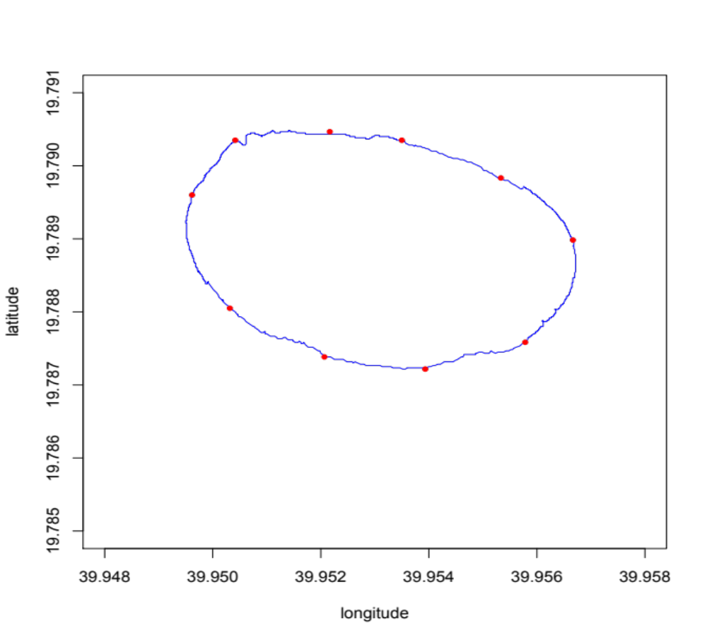
1. Mean total distance travelled per day
200 + 210 + 430 + 220 = total distance per day, averaged over entire detection period
Distances between pairs of detections
Within-reef movement only
200 m
210 m
430 m
220 m
Notes:
There were almost no between reef movements for the first 6 months of the study, so we focus on within-reef movement in this analysis
Firstly, we calculated all the pairwise distances between receivers, simply by measuring the distance around the reef crest (distances came from a track log by towing a GPS). We then calculated the distance travelled between each pair of sequential detections (always assuming that a fish took the shortest possible route between two receivers). So if two sequential detections came from the same receiver, then a 0 distance would be assigned.
We produced two measures of within-reef movement to comprehensively compare movement across all individuals:
Our first movement measure was the mean total distance an individual travelled over a 24 hour period,
We defined our 24 hours from dawn to dawn (using daily dawn and dusk times). The total distance travelled over the whole period of detection (max 6 months) was divided by the number of days of detections. This basically represents the mean cumulative distance an individual clocks up over the course of a day.

Slide 11
2. Mean maximum distance travelled per day
840 m = max distance per day, averaged over entire detection period
840 m
Notes:
The second measure was the mean maximum distance travelled in any 24 hour period, giving us an idea of ‘daily territory size’
This was the result of calculating the distance between the two furthest receivers a fish was detected over a whole day for each day of detection, then averaging these values.
To clean the data, we removed any days (dawn to dawn) that did not contain at least 2 detections during the day or 2 detections during the night with which to calculate a movement measure.
We also removed the 1st 24 hours following the time of release for each fish to allow it to acclimatize and started our measures from the following dawn.
We also removed any between-reef movements if these existed to make data from all fish comparable
After this data cleaning, our movement measures were calculated for 318 individuals

Slide 12
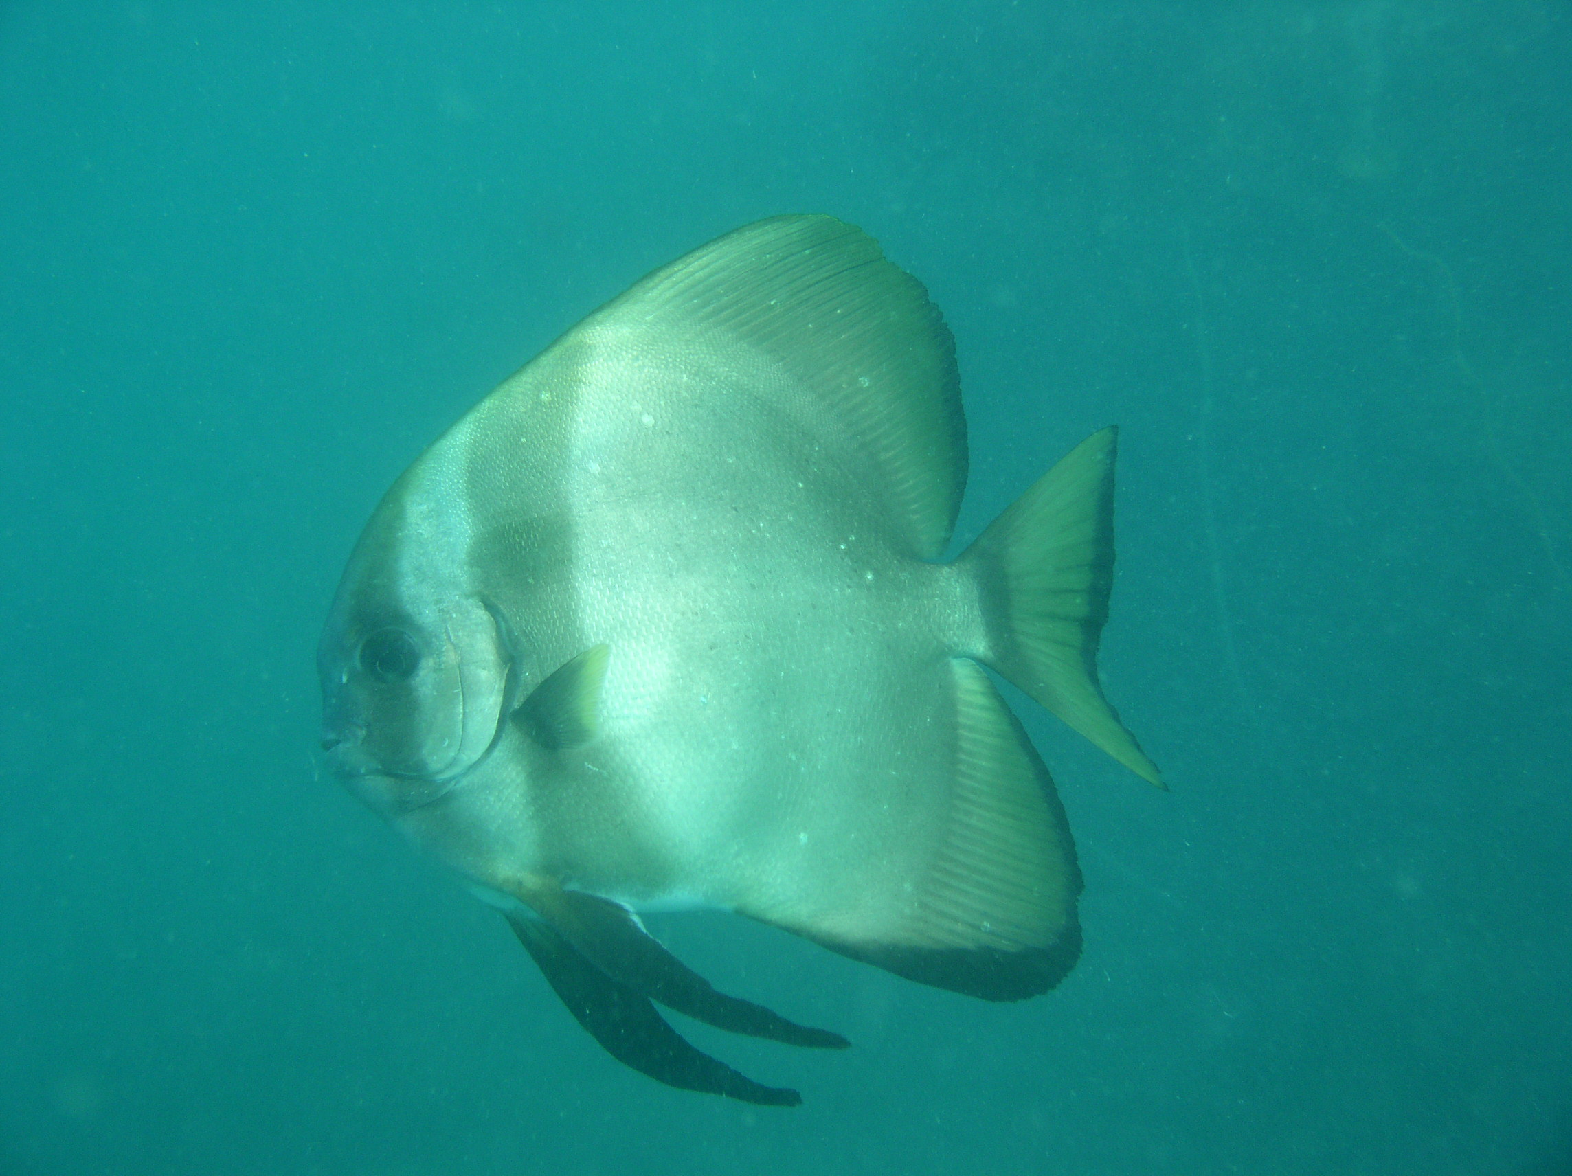
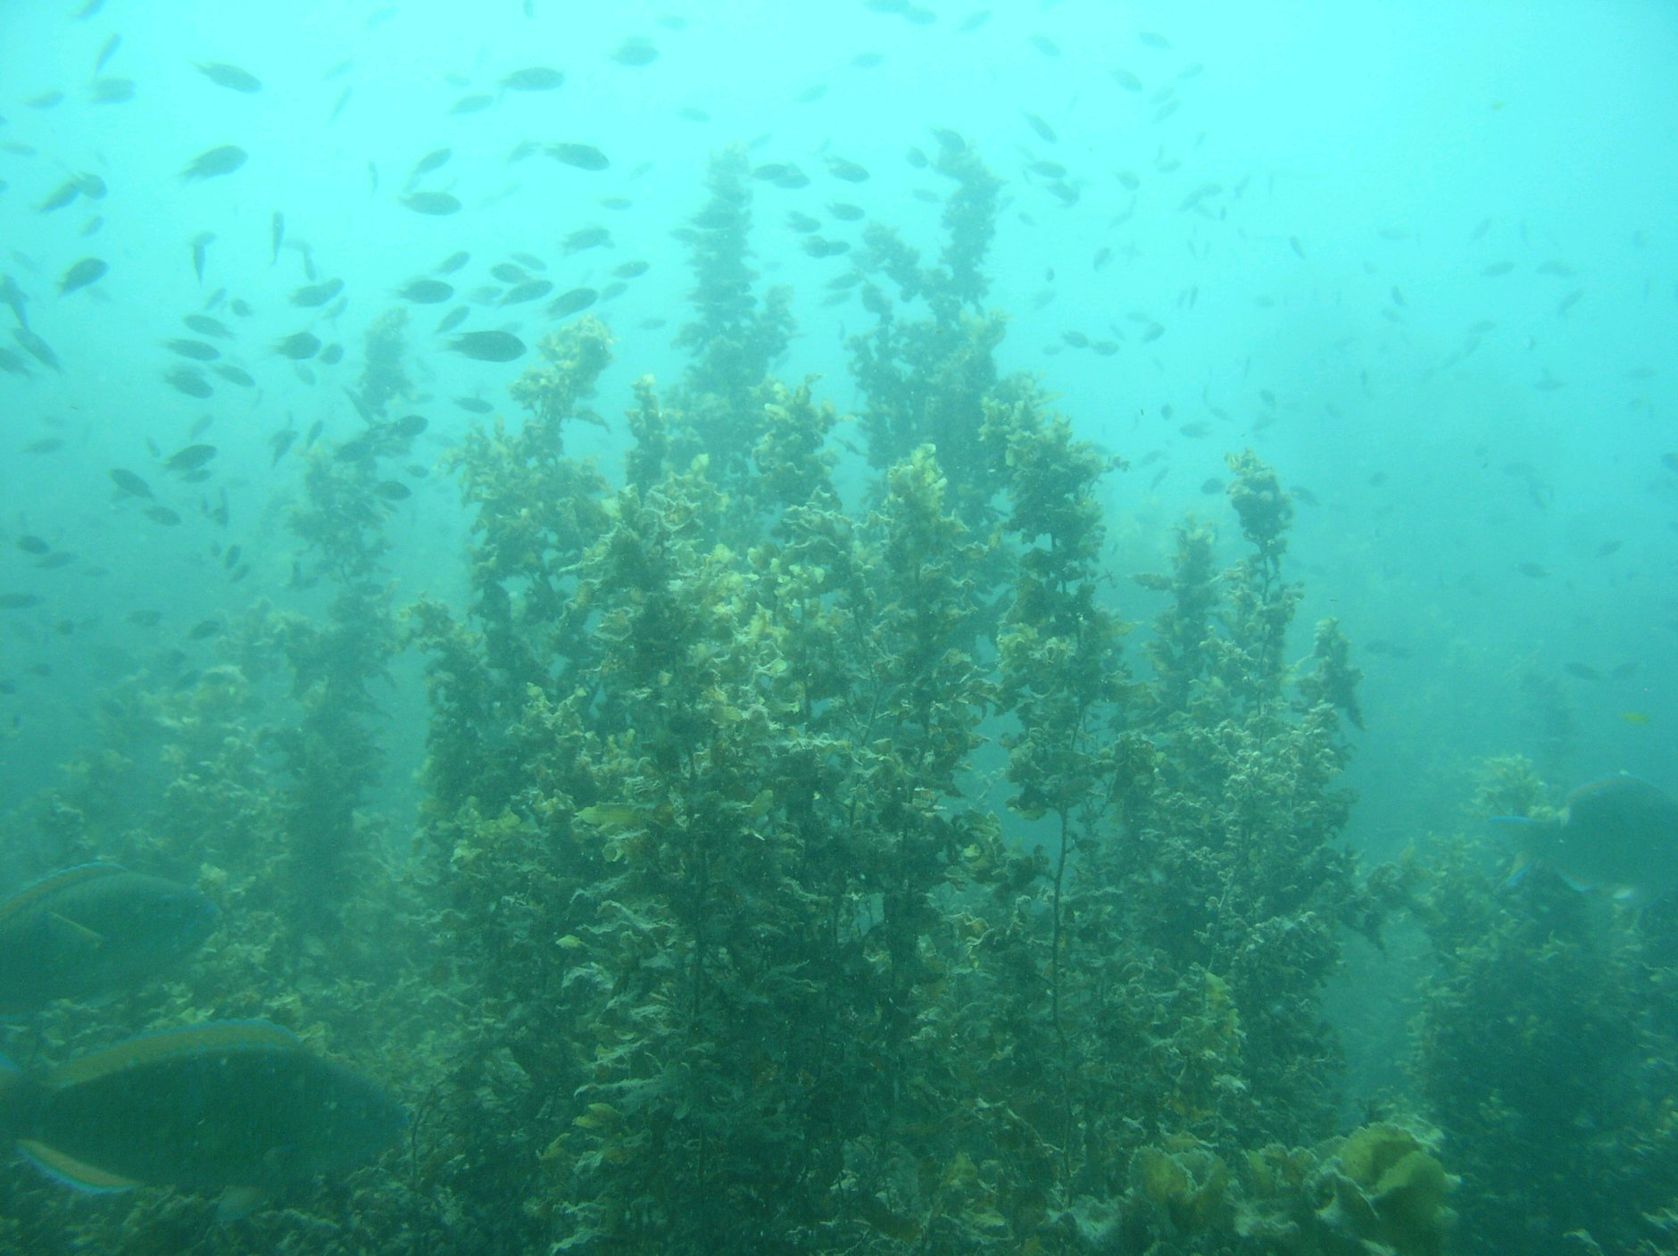
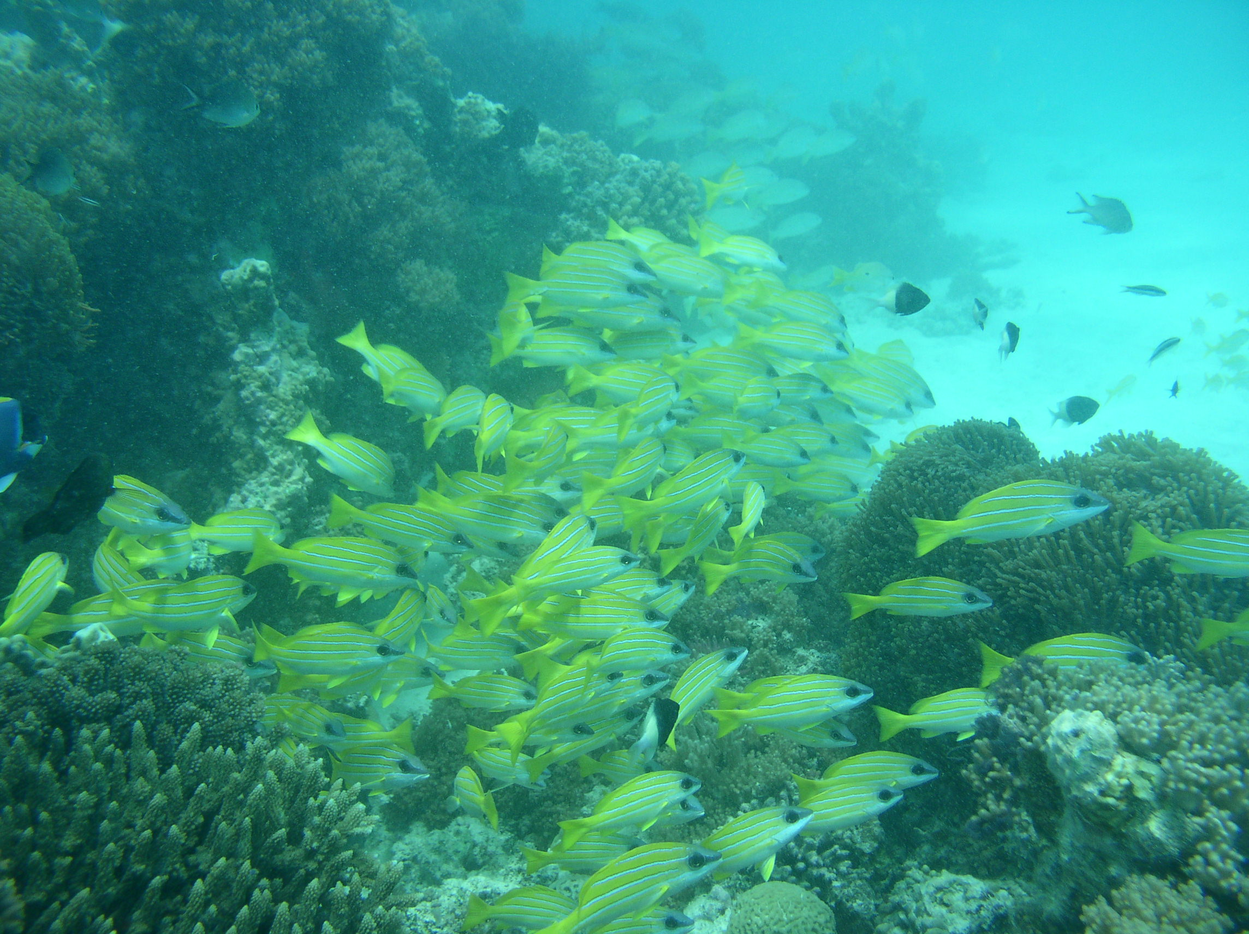
Hypotheses
Biological traits
Size
Diet
Shoaling behaviour
General Linear Model
Log mean total daily distance or Log mean max daily distance =
Fork Length + Max length + Trophic group + Shoaling + Condition + Species + Family
Notes:
We tested 3 main hypotheses relating to movement:
Firstly- that individual body size and max body size would influence movement, with the expectation that larger individuals or species move further, second, that feeding group would influence movement (species were assigned to one of 5 feeding groups based on the relative dominance of food items in their diet, dietary information came from Fishbase and the primary literature) with the expectation that diets that were poor in nutrition or scattered would elicit greater movement
Third, shoaling behaviour (defined according to Macneil et al 2008 as fish being consistently aggregated in groups of more than 5 individuals of any species, this category was assigned based on personal observation at the study sites and backed up by information, where available, in Fishbase), with the expectation that shoaling may allow individuals to travel further by reducing predation risk
We fitted a fully saturated model containing all predictors to each movement measure, and found the minimal model using backwards stepwise regression; distance measures were logged because of their distribution
Species and family were included as random factors, to control for similarities between individuals from the same species or family, body size was represented by fork length, and given there was a high correlation between individual fork length and weight, we included the residuals of weight over length as a measure of body ‘condition’

Slide 13
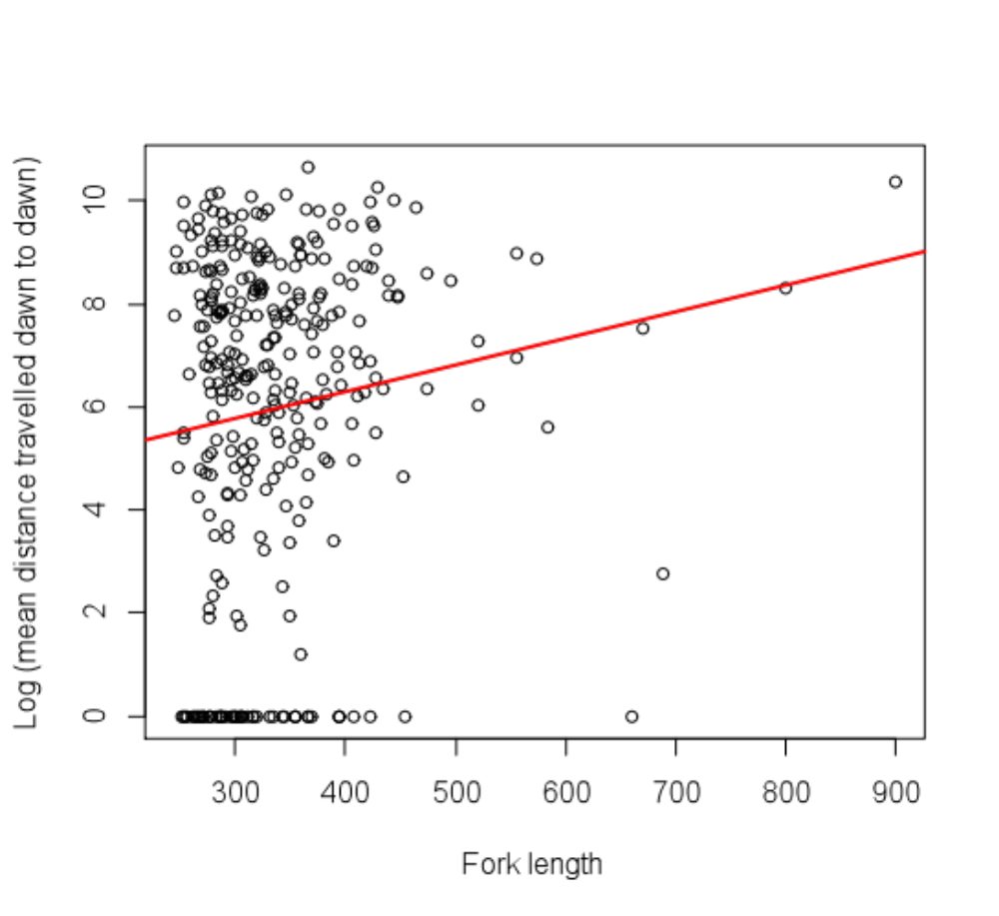
Significant effect of individual body size on total daily distance
p = 0.006 (and maximum daily distance, p = 0.005)
Notes:
Individual body size has a strong relationship with movement –we got movement values of zero for 52 individuals, meaning they were only detected by one receiver for their entire duration of detection, whereas other individuals travelled mean distances of up to 10-40 km per day. Interestingly, we got very similar results for both movement measures, suggesting that individuals with high ‘activity’ (total daily distance travelled) also have large daily home ranges

Slide 14
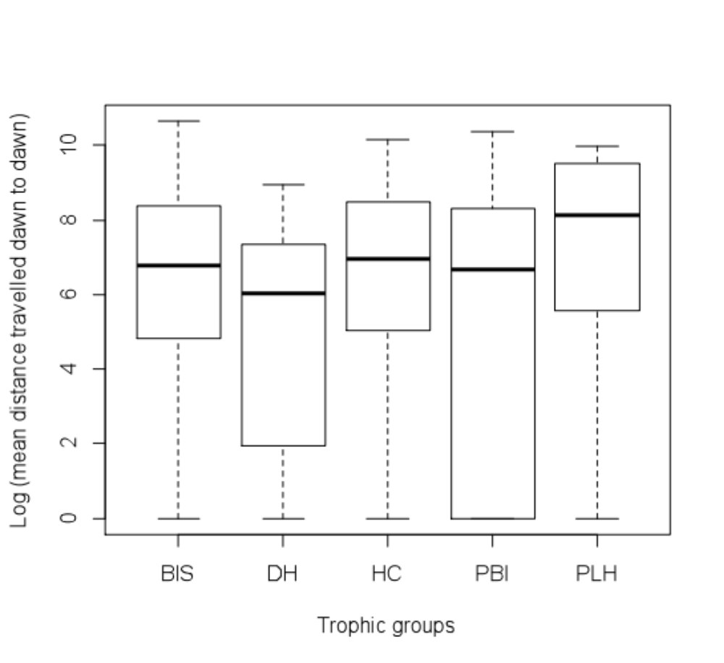
Significant effect of diet on total daily distance p = 0.029
and maximum daily distance p = 0.031
Benthic invertivores
Detritivores/Herbivores
Herbivores/Corallivores
Piscivores
Planktivores
Notes:
This is a box plot to represent the differences in movement between feeding groups. (BIS = benthic invertivore scavengers, DH = detritivore/herbivores, HC = herbivore/corallivores, PBI = fish predators, PLH = planktivores).
Movement varies significantly between feeding groups, with planktivores moving the most, and detritivores the least. Movement was most variable within predators, this result again was very similar for both movement measures, representing ‘activity’ and ‘territory size’

Slide 15
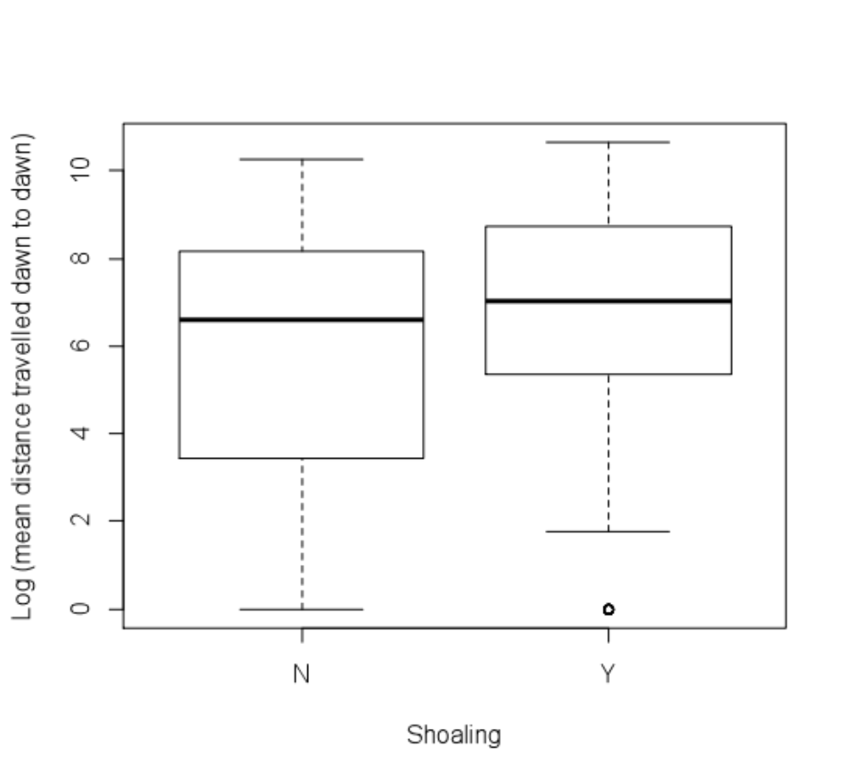
Marginally significant effect of shoaling behaviour on total daily distance p = 0.047
Notes:
Shoaling behaviour was only marginally significant, with shoaling species have slightly greater daily activity, however, it became non-significant when we looked at maximum daily distance. None of the other predictors (species, family, maximum size or condition) had any effect

Slide 16
Conclusions
We can predict movement from biological traits
Larger individuals are more active with larger home ranges, regardless of
taxonomy
Planktivores are most active, with largest home ranges, detritivores the least
Some feeding groups are more predictable than others
Nearly all fish stayed on their home reef (only 3 km circumference)
for 6 months
Notes:
We can predict movement from biological traits,
Larger individuals are more active and have larger home ranges, regardless of taxonomy; previous studies have suggested that larger individuals travel further, and body size is generally an important trait mediating the ecological dynamics and behaviours of marine species. We might expect individual body size to be related to movement given that body size is strongly linked to the risk of predation, the quantity of food needed and to some extent with the ability to swim long distances
Planktivores are the most active feeding group, with the largest home ranges (e.g. Naso hexacanthus). This makes sense given the shifting nature of currents on the reef; Generally previous studies have not had enough power to test whether movement varies between feeding groups
Some trophic groups are more predictable than others- fish predators appear to have a wide range of movement behaviours, probably because of the existence of different predation strategies- e.g. ambush predators (groupers) vs. cruising predators (jacks)
Nearly all fish stayed solely within their home reef over the 6 month duration, even though these reefs were not particularly large
We’d like to emphasise that this analysis and conclusions come from half of our expected data, so we look forward to seeing if these patterns hold when we include the next 6 months of data

Slide 17
Implications
Can incorporate likely movement behaviours in to MPA design
Small MPAs would seem to effectively protect most of the fish community
Larger fish need larger MPAs!
Isolated reefs vulnerable to being fished out
Notes:
We can predict movement from biological traits, making it possible to inform MPA design to incorporate the likely movement behaviours of the species or ecological functions they are trying to protect, without necessarily having to measure movement at that location or for that particular species composition
Almost no between reef movement when reefs are fully separated by open water (so far)
The majority of species, including large species and individuals, such as large groupers (Ephinephelus fuscoguttatus, plectropomus pessuliferus), humphead wrasse (cheilinus undulatus) and jacks (caranx melampygus) seem to be predominantly site-associated, meaning small MPAs (one reef) with no connecting habitat to other reefs, are able to provide effective protection for the entire fish community, with the possible exception of reef-associated pelagics (barracuda, tuna etc)
However, given that individual size predicts movement well, larger fish need larger MPAs!
It is therefore likely that when fish communities are fished, the average home range size decreases as the size of fish decrease. This may have knock-on effects for maintaining the spatial scale of reef processes
Lack of movement between disconnected reefs also means isolated reefs are vulnerable to being fished out, and will rely on larval transport to maintain populations if they are subjected to fishing; Possibly it is the open-water between reefs that is dissuading fish from moving, there might be more movement if it was shallow non-reef habitat. Given these types of reef are very common in the Red Sea, this has implications for fisheries management and suggests these types of reef may be particularly vulnerable.

Slide 18
Acknowledgements
Funding
King Abdullah University of Science and Technology, Saudi Arabia
Red Sea Research Center- Prof Michael Berumen, Prof Jim Luyten
SABIC (Saudi Basic Industries Cooperation) Postdoctoral fellowship
Tane Sinclair-Taylor, Andy Hoey, Luke Thompson, Maha Khalil, Jessie Masterman, Jess Bouwmeester, Sou Miyake, Felipe Villa, Jesse Cochran, Gerrit Nanninga, Julia Spaet, Lautaro Rayo, Alex McClaren, Bert Rioux, Xianzhe Gong, Daniela Catania and Mehreen Mughal (Red Sea Research Center) for fieldwork assistance
Coastal and Marine Resources Core Lab (CMOR, KAUST) for logistical support
Dale Webber (VEMCO) for technical advice
Dream Divers (Jeddah, Saudi) for boat/crew support
Questions? elizabeth.tyler@kaust.edu.sa
Notes:
This project was supported by research funding from KAUST, and from the Red Sea Research Center. Lizzie Tyler was also supported by a one-year SABIC postdoctoral fellowship
The enormous amount of fieldwork and logistics involved in this project was heavily supported by volunteers from my lab and the RSRC and by the core lab at KAUST, who provided handline fishermen and technical support installing moorings, also by a private dive company in Jeddah
Vemco were generous with their technical advice on tag specifications
I’d be happy to take questions and if anyone is interested in detailed discussion, please also contact Lizzie on the following e-mail address.

